Slide 1





Clytia hemisphaerica GPCR complement and classification
PhD: Gonzalo Quiroga Artigas
Laboratoire de Biologie du développement
de Villefranche sur mer
Thesis supervisor: Evelyn Houliston
Marie Curie ITN – Neptune
22/02/2016

Slide 2
Purposes
GPCR Class distribution and amount in Clytia hemisphaerica
Availability of separated FASTA files for each Class

Slide 3
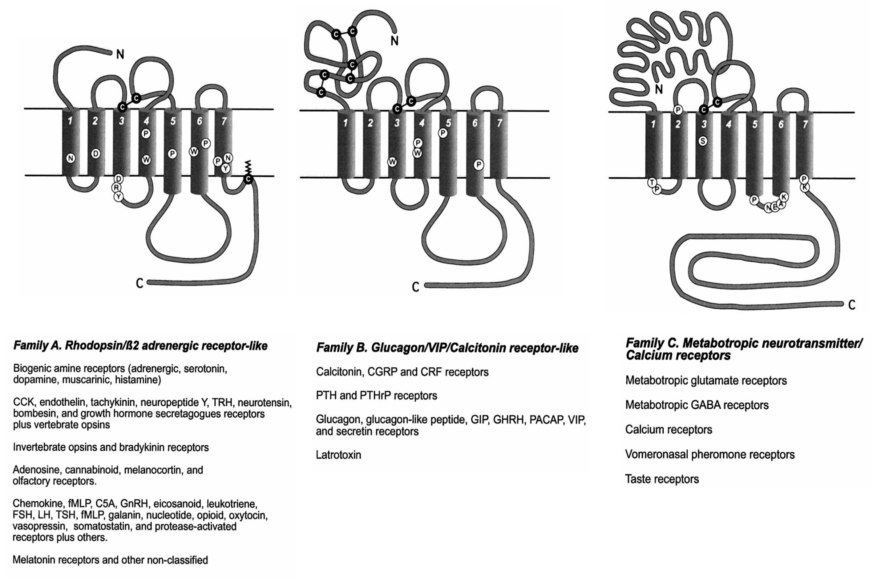
3 MAIN FAMILIES OF G PROTEIN COUPLED RECEPTORS (GPCRs)
(Modified from Gether, 2000)
Notes:
Fotos de los 3 clases GPCRs con mini descripcion de variedad, longitud N-terminal, etc
Hay tb Adhesion family and Frizzled family
Long N-terminal domain in Secretin-like receptor family. It contains conserved cysteine residues that may form disulfide bonds.

Slide 4

RNA-Seq data
12 stages
2 bio replicates
mature medusa (female)
mature medusa (male)
oocyte
gastrula
baby medusa
planula 1d,2d,3d
polyp head
primary polyp
gonozooid
stolon

Slide 5
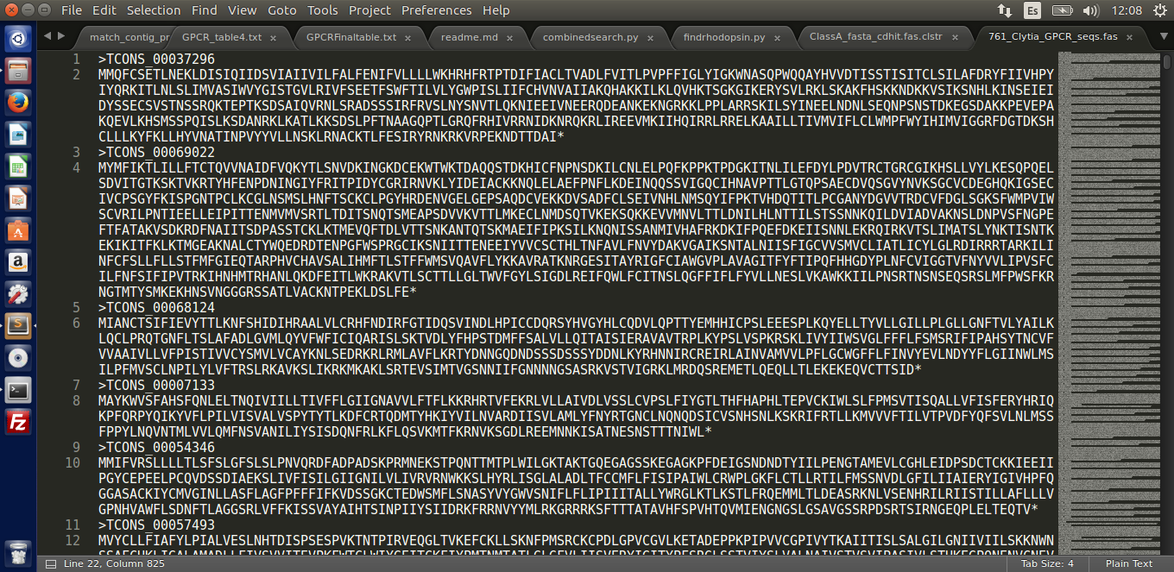
Starting material

Slide 6
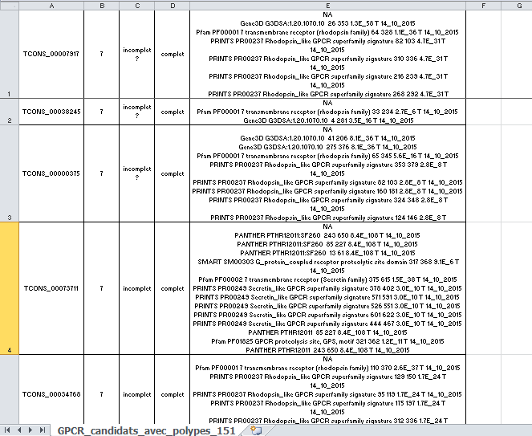
Starting material

Slide 7
Excell File with contig names and PFAM information about GPCR class
4 Files with contig names and unnecessary information about class…
Class A
Class B
All Classes mixed
PYTHON
SCRIPT
Class
Other
Class C

Slide 8
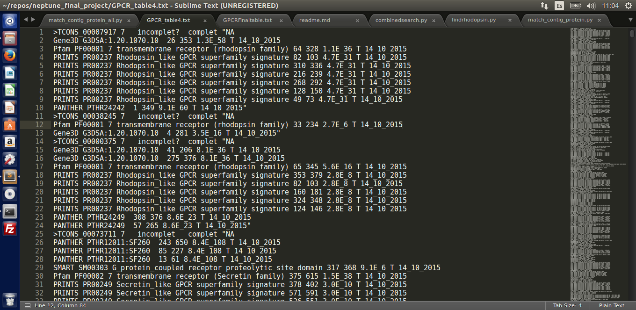
Text Wrangling

Slide 9
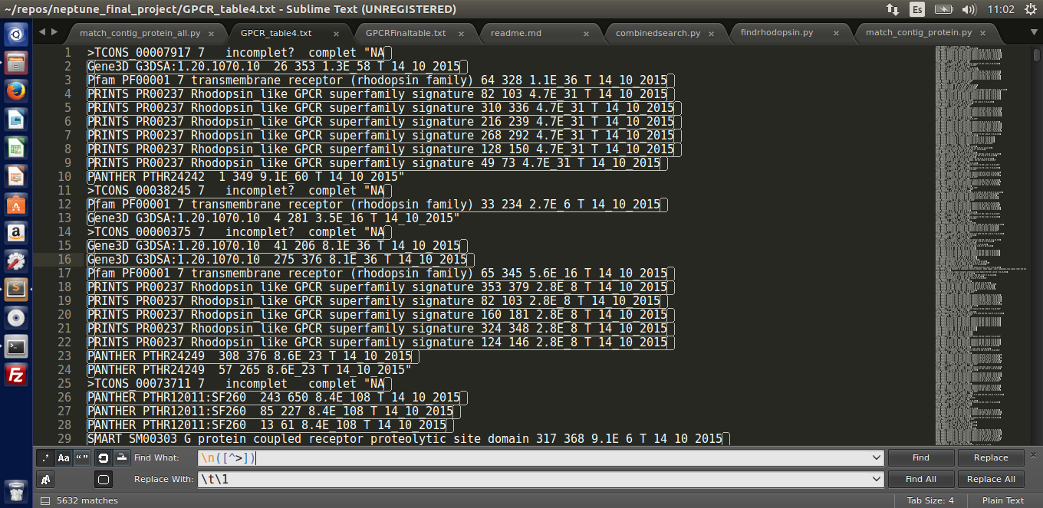
Text Wrangling

Slide 10
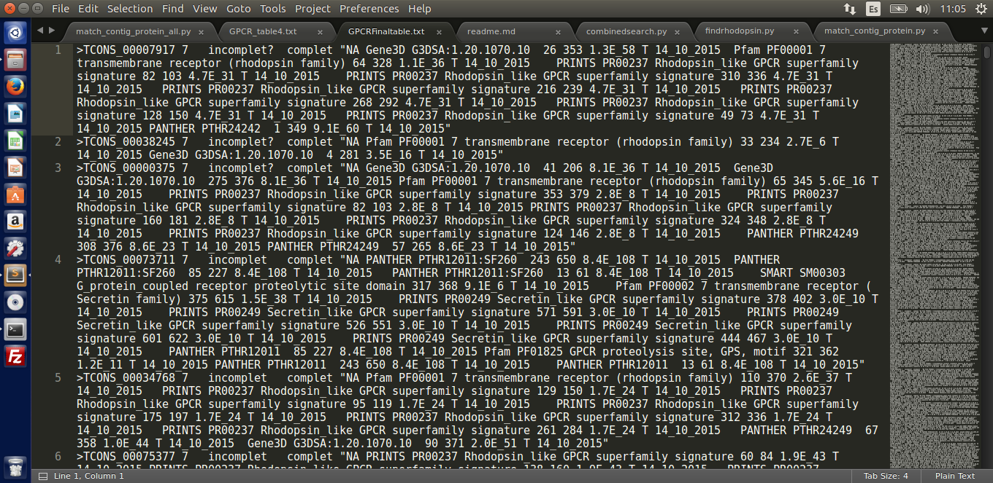
Text Wrangling

Slide 11
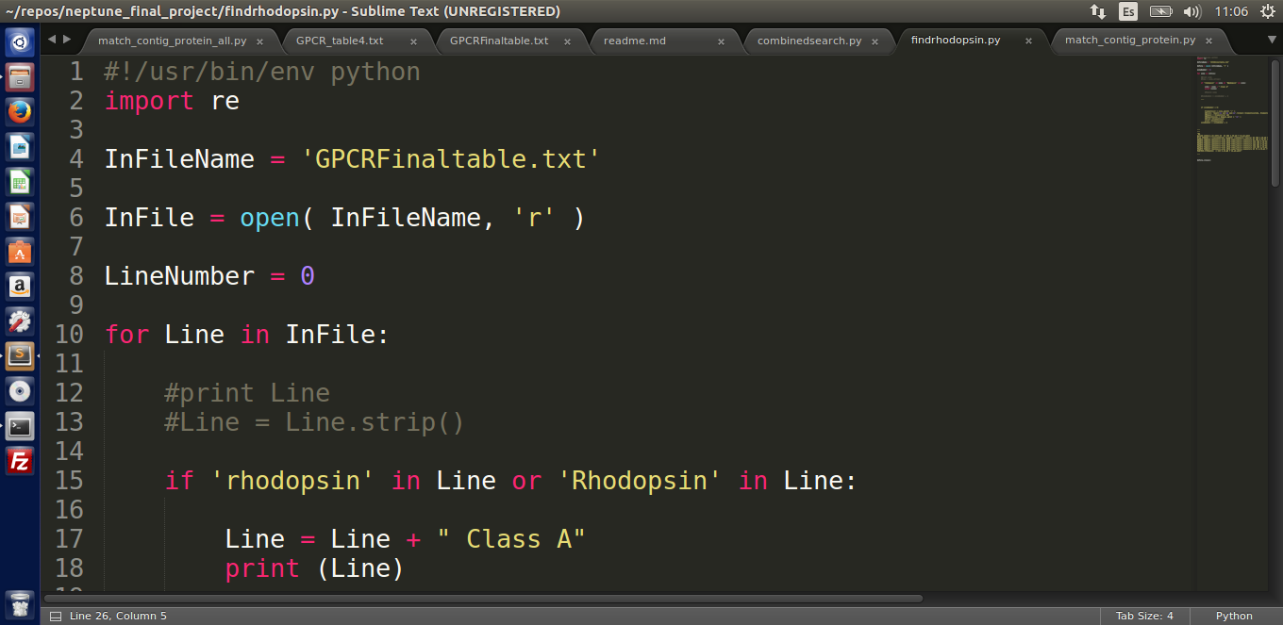
Scripting in Python (1)

Slide 12
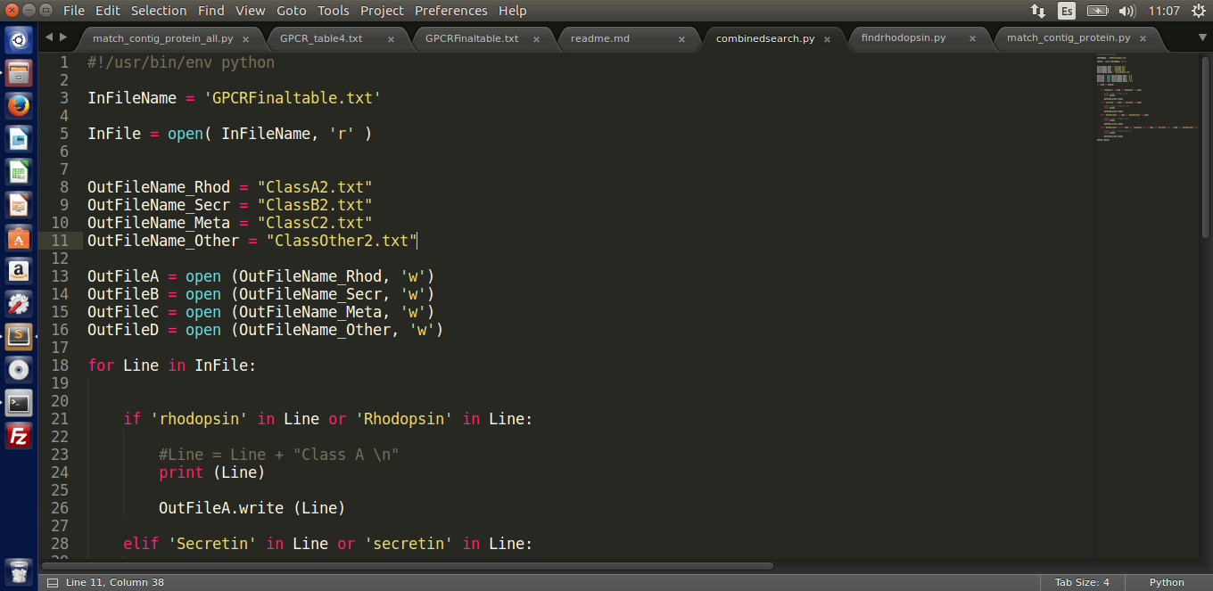
Scripting in Python (1)

Slide 13
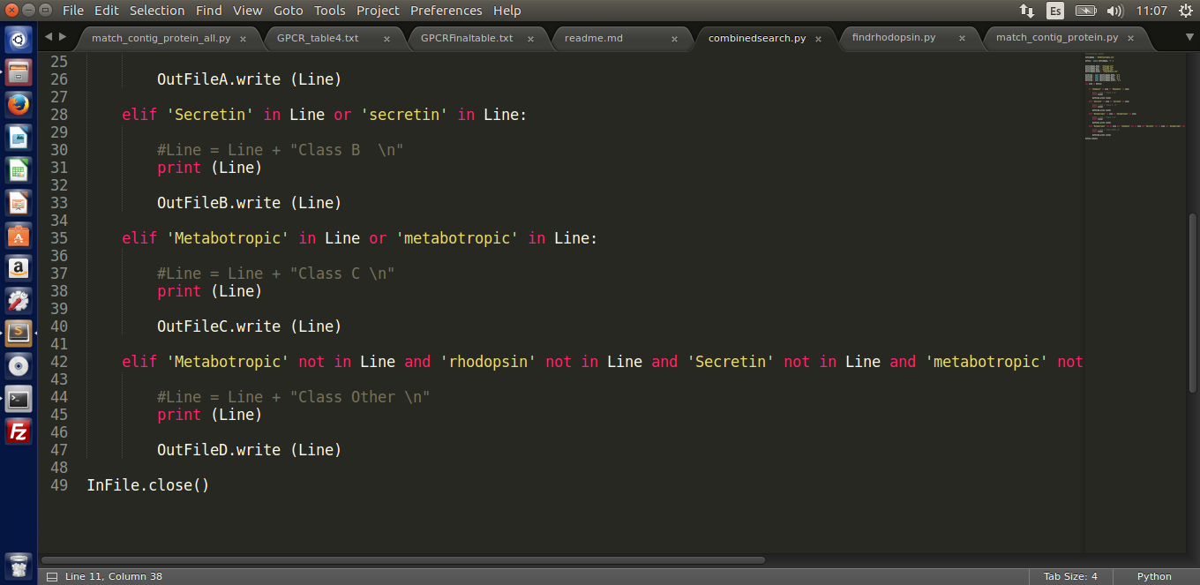
Scripting in Python (1)

Slide 14
4 Files with contig names and unnecessary information about class…
Fasta File with contig names and protein sequences
Class A
Class B
All Classes mixed
Class
Other
Class C
PYTHON
SCRIPT
Class A
Class B
4 Fasta Files with contig names and protein sequences for each Class of GPCR
Class
Other
Class C

Slide 15
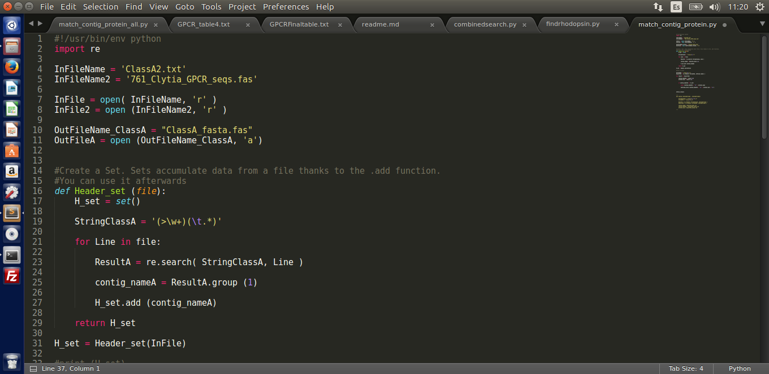
Scripting in Python (2)

Slide 16
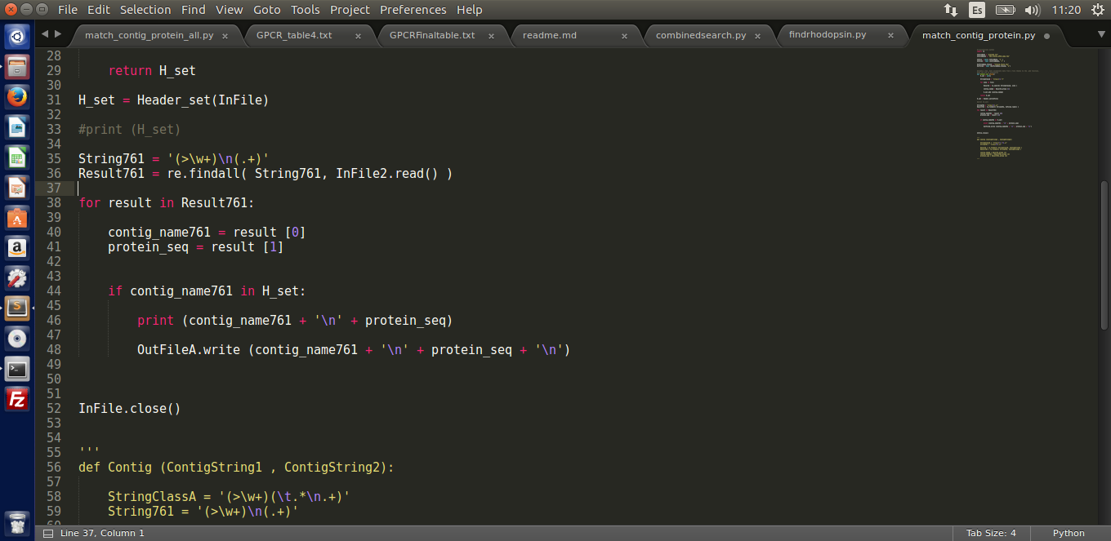
Scripting in Python (2)

Slide 17
Class A
Class B
4 Fasta Files with contig names and protein sequences for each Class of GPCR
Class
Other
Class C
Cdhit to get rid of redundancy!
-c 0,95
Class A
Class B
4 Fasta Files with contig names and protein sequences for each Class of GPCR
Class
Other
Class C

Slide 18
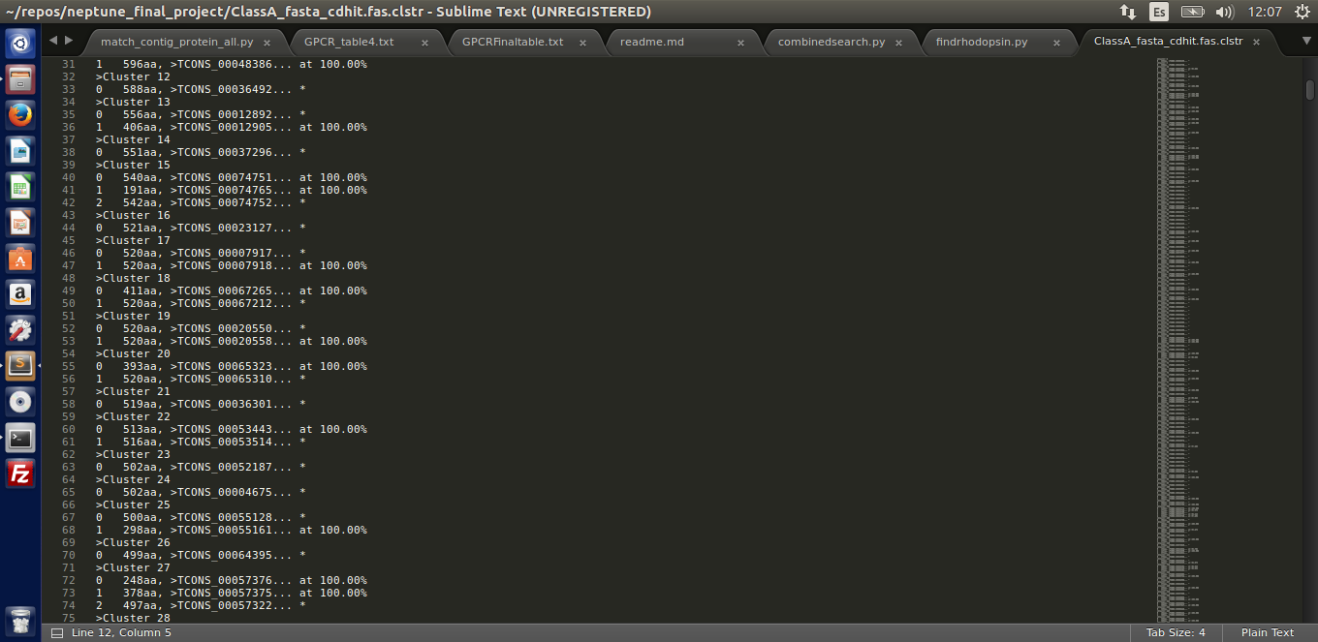
CDHIT

Slide 19
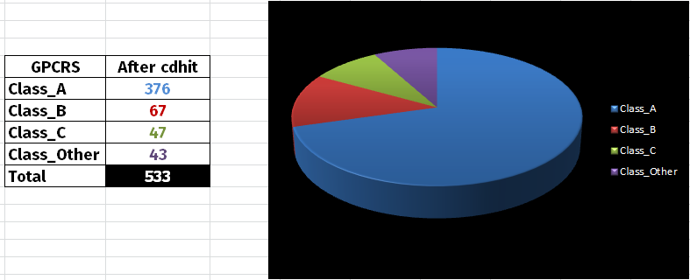
GPCR Class distribution and amount in Clytia hemisphaerica
Availability of separated FASTA files for each Class

Slide 20
